Slide 1
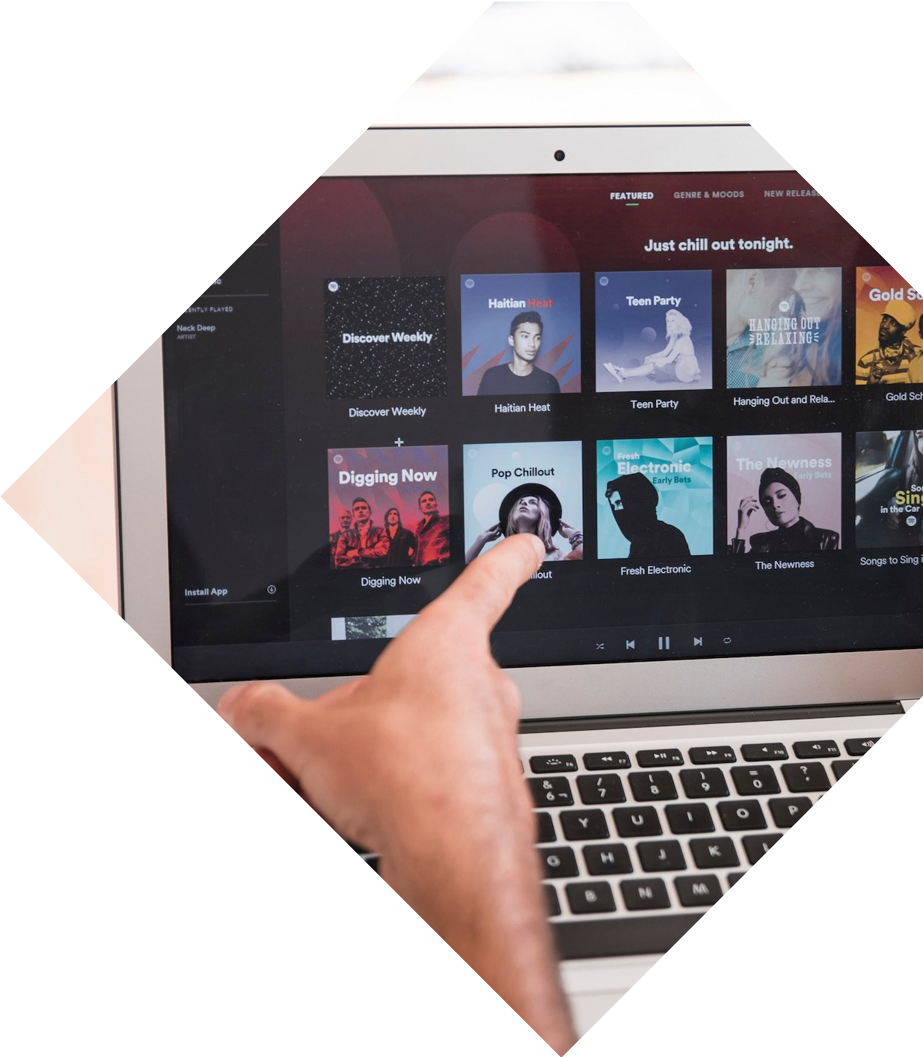

Harnessing the Power of Sentiment Analysis in Music Recommendation: Analyzing Captions for Enhanced User Experience

Slide 2


Use Case
Sentiment analysis has significantly impacted large corporates aiming to boost likability and features. By leveraging sentiment analysis, these corporations can gauge user emotions, refining their products and services for an enhanced customer experience. This discussion delves into employing sentiment analysis to enhance music recommendations and its potential benefits.

Slide 3

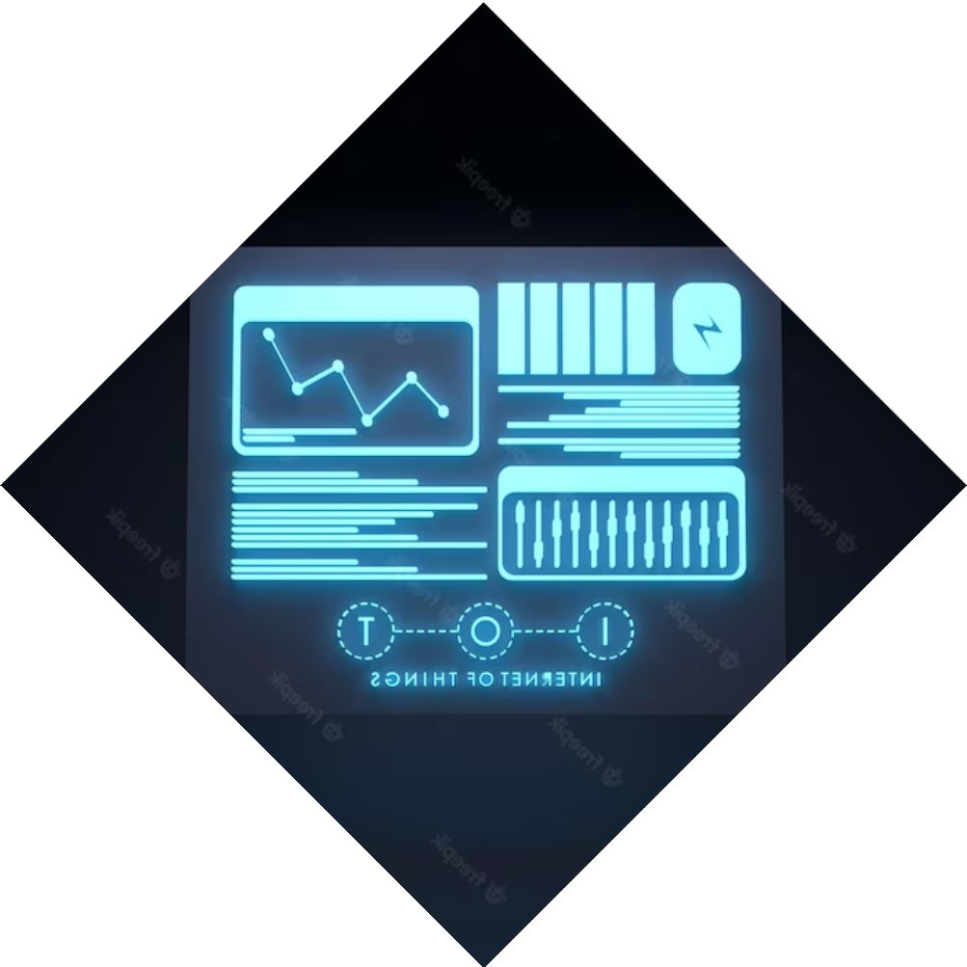
What is Sentiment Analysis?
Sentiment analysis is the process of using natural language processing and machine learning techniques to identify and extract subjective information from text. It is used in various industries, including music, to analyze the emotions and opinions expressed in captions and reviews.

Slide 4


Target Audience
This product will be utilized by individuals engaged in social media platforms, catering to their music preferences. People who use such social media apps will benefit from sentiment analysis, which enhances music recommendation engines by decoding emotional cues from captions, resulting in improved and precise song suggestions.

Slide 5


Benefits of the Product
Amplified engagement levels among users. Elevated user experience through personalized recommendations.
Strengthened community ties through shared musical preferences.
Simplified expression of individuals' feelings and emotions, fostering open communication of
thoughts and moods.

Slide 6
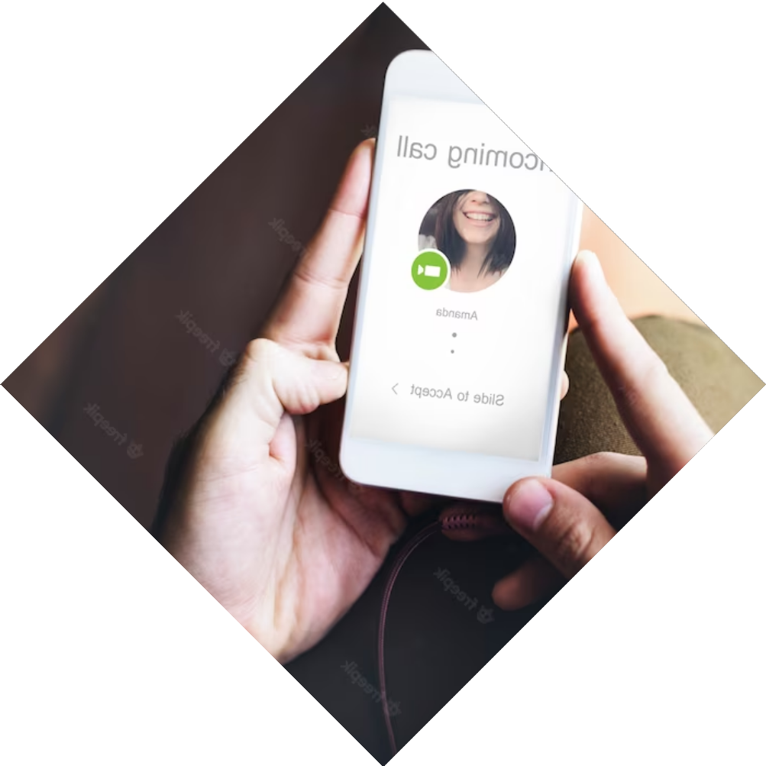
How is our Product Di£erent?
This innovative product is entirely indigenous, showcasing its uniqueness.
Furthermore, its versatility extends beyond its core function, with potential applications including leveraging open CV technology.

Slide 7
Conclusion
Sentiment analysis is a powerful tool for enhancing the user experience in music recommendation. By analyzing the emotions and opinions expressed in captions, music recommendation engines can make more accurate recommendations based on the user's emotional state and preferences.

